Slide 1
Random Forest
Hua Lin 11/9/2021
Tree ring and environmental change group
Xishuangbanna Tropical Botanical Garden

Slide 2
Definition
Random forest (or random forests) is an ensemble classifier that consists of many decision trees and outputs the class that is the mode of the class's output by individual trees.
The term came from random decision forests that was first proposed by Tin Kam Ho of Bell Labs in 1995.
The algorithm for inducing a random forest was developed by Leo Breiman (2001) and Adele Cutler；The method combines Breiman's "bagging" idea and the random selection of features.

Slide 3
Decision trees
Decision trees are individual learners that are combined. CART Classification and regression trees (Breiman et al. 1984)
A tree can be built by splitting the source set into two subsets based on an attribute value test.
This process is repeated on each derived subset in a recursive manner called recursive partitioning.
The recursion is completed when the subset at a node has all the same value of the target variable, or when splitting no longer adds value to the predictions.

Slide 4
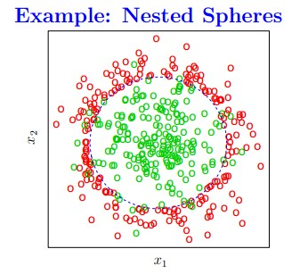
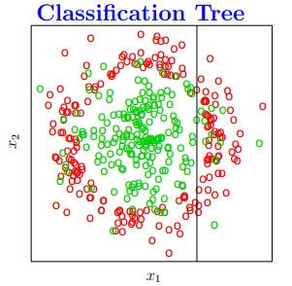
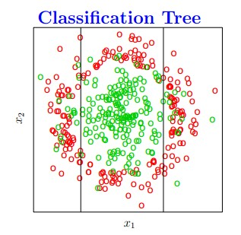
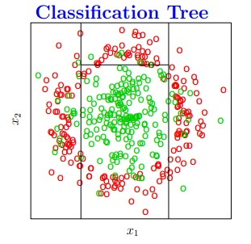
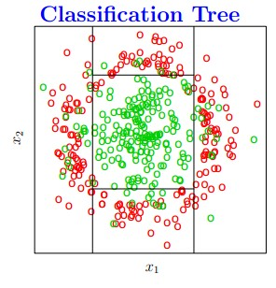
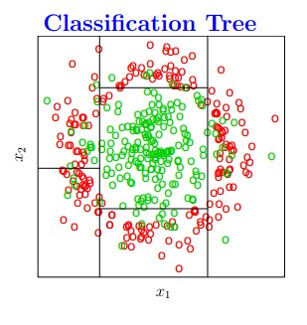

Slide 5
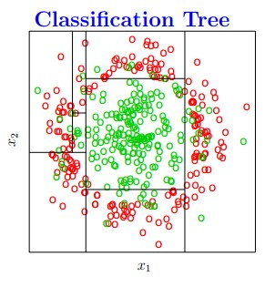
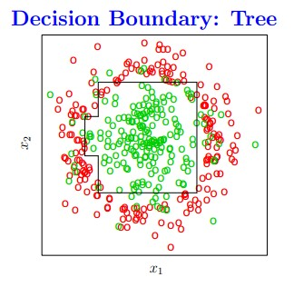

Slide 6
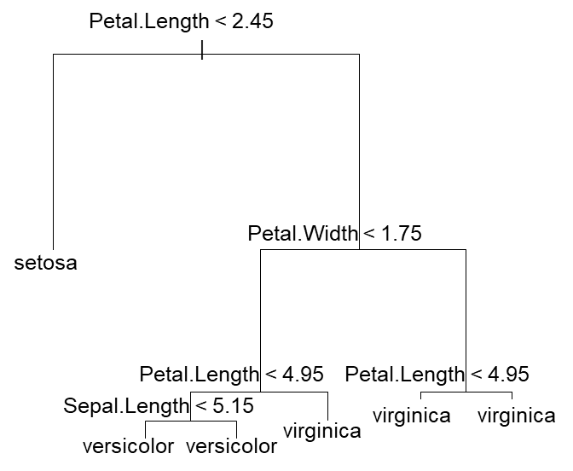
Decision tree (code: tree)
Regression tree (code: tree)
wt < 2.26
|
cyl < 7
30.07
cyl < 5
hp < 192.5
22.58
19.74
16.79
13.41

Slide 7
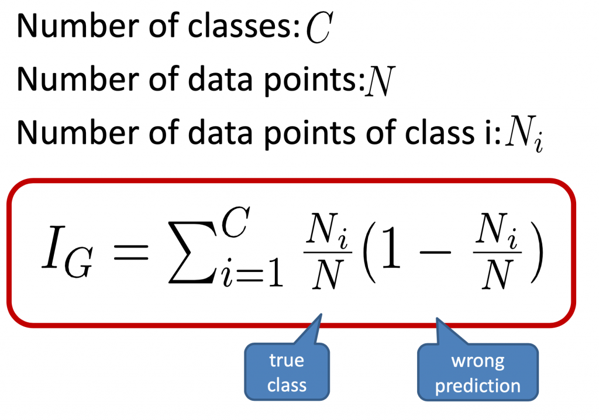
How to classify? —— Gini Impurity
Gini impurity
Gini Impurity is the probability of incorrectly classifying a randomly chosen element in the dataset if it were randomly labeled according to the class distributionin the dataset.

Slide 8

Gini impurity
4
3
3
Class possibility
4/10
3/10
3/10
misclassification
0.24
0.21
0.21
4/10*（3/10+1/10）
Gini impurity: 0.24+0.21+0.21 = 0.66

Slide 9
Ensemble classifier
Tree models are simple, often produce noisy (bushy) or weak (stunted) classifiers.
Ensemble learning: After getting the prediction from each model, we will use model averaging techniques like weighted average, variance or max voting to get the final prediction. This results in better accuracy avoiding overfitting, and reduces bias and co-variance.
Bagging
Boosting:
The term ‘Boosting’ refers to a family of algorithms which converts a weak learner to a strong learner.
These multisets of data are used to train multiple models. As a result, we end up with an ensemble of different models. The average of all the predictions from different models is used.

Slide 10
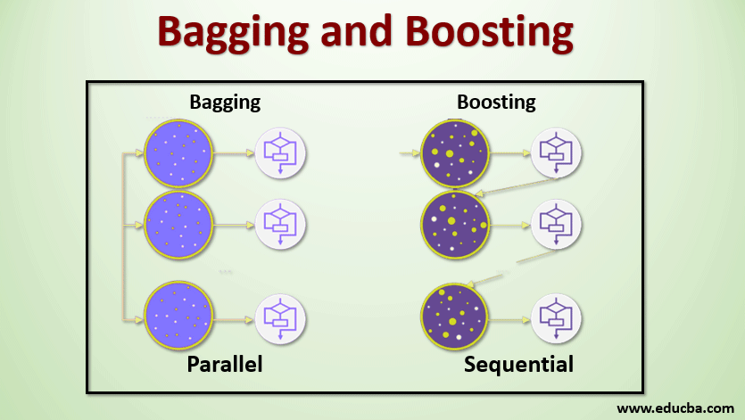
Fit many large trees to bootstrap-resampled versions of the training data, and classify by majority vote.
In each iteration, data points that are mispredicted are identified and their weights are increased so that the next learner pays extra attention to get them right.

Slide 11
Algorithm
Each tree is constructed using the following algorithm:
Let the number of training cases be N, and the number of variables in the classifier be M.
We are told the number m of input variables to be used to determine the decision at a node of the tree; m should be much less than M.
Choose a training set for this tree by choosing n times with replacement from all N available training cases (i.e. take a bootstrap sample). Use the rest of the cases to estimate the error of the tree, by predicting their classes.
For each node of the tree, randomly choose m variables on which to base the decision at that node. Calculate the best split based on these m variables in the training set.
Each tree is fully grown and not pruned (as may be done in constructing a normal tree classifier).
For prediction a new sample is pushed down the tree. It is assigned the label of the training sample in the terminal node it ends up in. This procedure is iterated over all trees in the ensemble, and the average vote of all trees is reported as random forest prediction.

Slide 12
Random forest
Fancier version of bagging.
Feature
M
Author, genre
Genre, design
Publisher, price
Decision tree
m
N
Decision tree
Decision tree

Slide 13
Features and Advantages
The advantages of random forest are:
It is one of the most accurate learning algorithms available. For many data sets, it produces a highly accurate classifier.
It runs efficiently on large databases.
It can handle thousands of input variables without variable deletion.
It gives estimates of what variables are important in the classification.
It generates an internal unbiased estimate of the generalization error as the forest building progresses.
It has an effective method for estimating missing data and maintains accuracy when a large proportion of the data are missing.

Slide 14
Features and Advantages
It has methods for balancing error in class population unbalanced data sets.
Generated forests can be saved for future use on other data.
Prototypes are computed that give information about the relation between the variables and the classification.
It computes proximities between pairs of cases that can be used in clustering, locating outliers, or (by scaling) give interesting views of the data.
The capabilities of the above can be extended to unlabeled data, leading to unsupervised clustering, data views and outlier detection.
It offers an experimental method for detecting variable interactions.

Slide 15
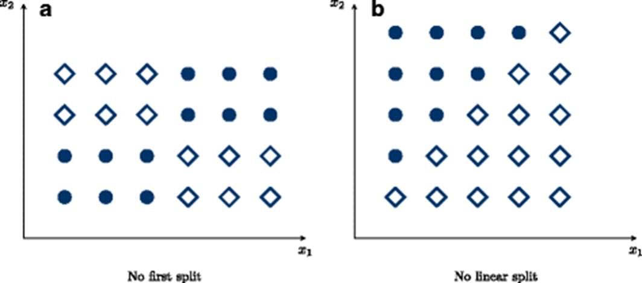
Disadvantages
Random forests have been observed to overfit for some datasets with noisy classification/regression tasks.
For data including categorical variables with different number of levels, random forests are biased in favor of those attributes with more levels. Therefore, the variable importance scores from random forest are not reliable for this type of data.
Can’t find the first split

Slide 16
Conclusions & summary:
Fast fast fast!
RF is fast to build. Even faster to predict!
Practically speaking, not requiring cross-validation alone for model selection significantly speeds training by 10x-100x or more.
Fully parallelizable … to go even faster!
Automatic predictor selection from large number of candidates
Resistance to over training
Ability to handle data without preprocessing
data does not need to be rescaled, transformed, or modified
resistant to outliers
automatic handling of missing values
Cluster identification can be used to generate tree-based clusters through sample proximity

Slide 17
RM - Additional information
Estimating the test error:
While growing forest, estimate test error from training samples
For each tree grown, 33-36% of samples are not selected in bootstrap, called out of bootstrap (OOB) samples
Using OOB samples as input to the corresponding tree, predictions are made as if they were novel test samples
Through book-keeping, majority vote (classification), average (regression) is computed for all OOB samples from all trees.
Such estimated test error is very accurate in practice, with reasonable N

Slide 18
RM - Additional information
Estimating the importance of each predictor:
Denote by ê the OOB estimate of the loss when using original training set, D.
For each predictor xp where p∈{1,..,k}
Randomly permute pth predictor to generate a new set of samples D' ={(y1,x'1),…,(yN,x'N)}
Compute OOB estimate êk of prediction error with the new samples
A measure of importance of predictor xp is êk – ê, the increase in error due to random perturbation of pth predictor

Slide 19
R Packages
package | RStudio downloads in the a month in 2016
randomForest | 28353
xgboost | 4537
randomForestSRC | 2291
ranger | 1347
Rborist | 284
R packages for random forest
package | RStudio downloads in a last month in 2016
rpart | 21585
party | 14338
extraTrees | 1408
RRF | 516
rotationForest | 437
rFerns | 431
obliqueRF | 252
wsrf | 232
randomUniformForest | 189
trimTrees | 134
roughrf | 126
randomForestSRC(Syn) | 2291
Associated R packages for random forest

Slide 20
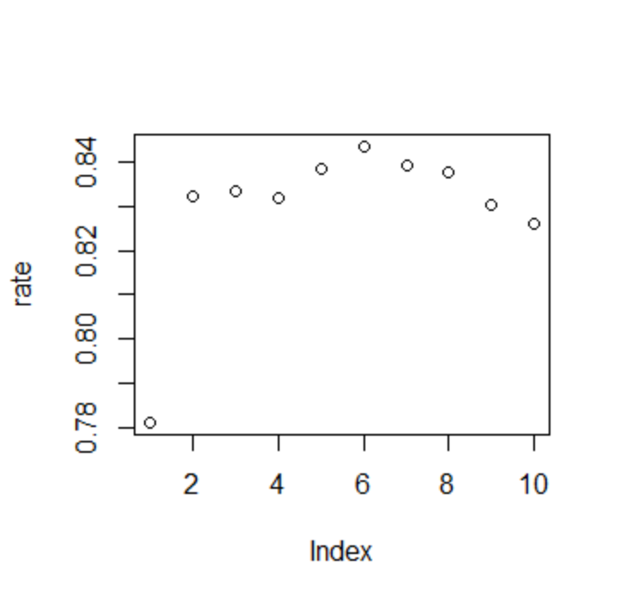
The determination of m and n
names(mtcars)
n=length(names(mtcars))
n
rate=1
for(i in 1:(n-1)){
set.seed(1234)
rf_train<-randomForest(formula=mpg~.,data=mtcars,mtry=i,ntree=1000)
rate[i]<-mean(rf_train$rsq) #calculate the mean var explained rate
print(rf_train)
}
plot(rate)

Slide 21
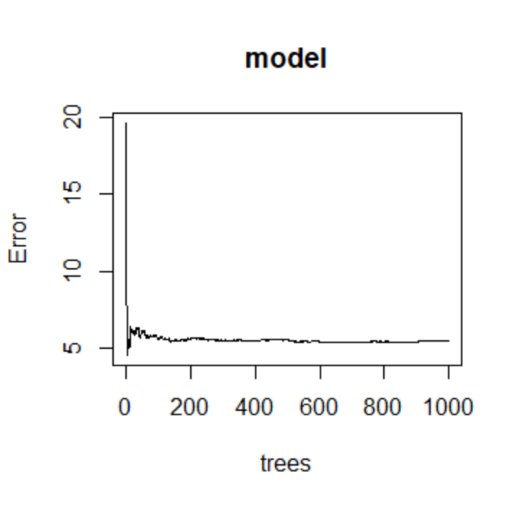
set.seed(100)
rf_train<-randomForest(formula=mpg~.,data=mtcars,mtry=9,ntree=1000)
plot(rf_train)

Slide 22
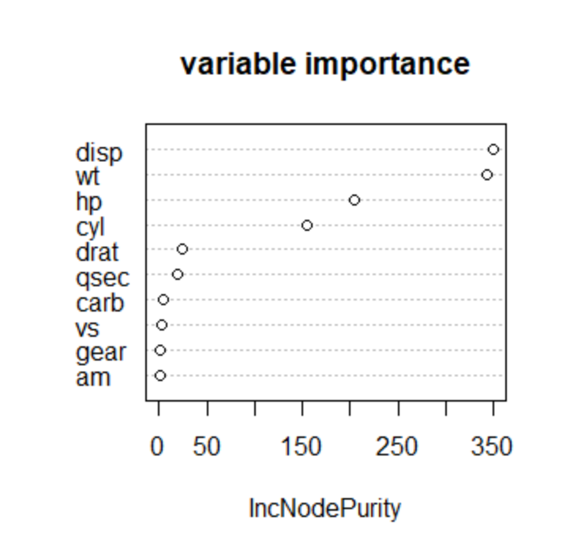

Slide 23
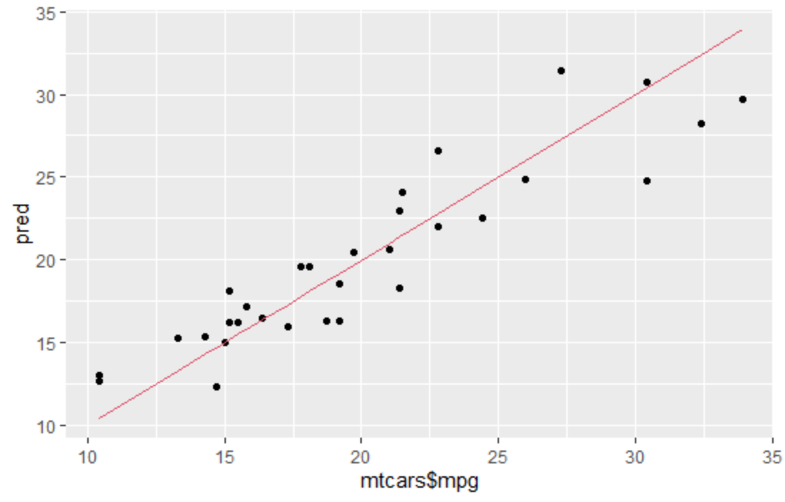
Prediction
pred = predict(model, data=mtcars);library(ggplot2)
ggplot()+
geom_point(aes(x=mtcars$mpg,y=pred))+
geom_line(aes(x=mtcars$mpg,y=mtcars$mpg),col=2)

Slide 24
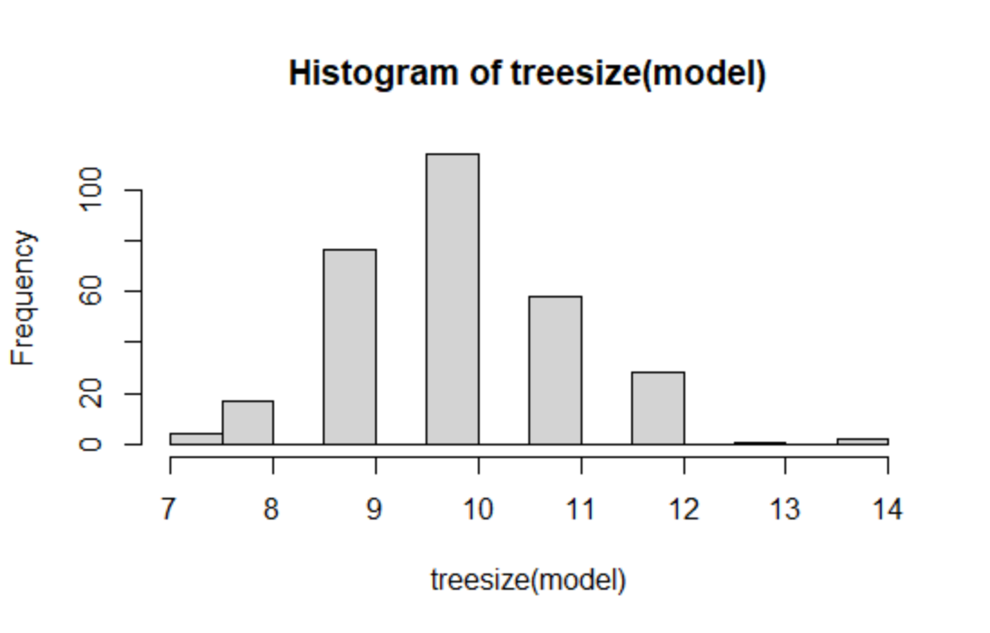
Tree size (number of nodes)
hist(treesize(model))

Slide 25
Thank you!

